Slide 1



PROJECT – III GRAPHER
CME1251 Project Based Learnıng-I
BY
2018510016 SADULLAH CİHAN
2018510023 ÖZCAN ELMACI
2018510013 MEHMET FATİH BİRDİR

Slide 2
OUTLINE
Code
Sleep
Eat
INTRODUCTION
PROGRESS SUMMARY
Requirements
Task Sharing, Scheduling
Completed Tasks
Incomplete Tasks: Reasons, Explanations
Additional Improvements
Problems Encountered
Algorithms and Solution Strategies
Screeshots
Conclusion, References

Slide 3
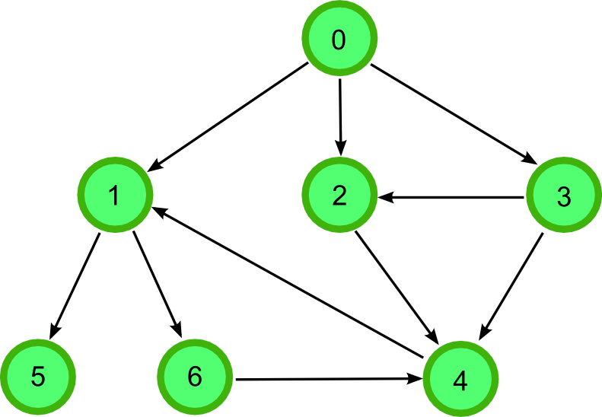
INTRODUCTION
25*40 board
Just ‘directed graph’
User can draw, load, save a graph
Also R, R², R³ … Rn, R* ,R min

Slide 4



PROGRESS SUMMARY
REQUIREMENTS
C# knowledge
Visual Studio
Teamwork
Trello
Canva

Slide 5

PROGRESS SUMMARY
Task Sharing
Sadullah Cihan :
Loading
Redrawing
Tracing
Forming R matrix
Calculating RN
R* and Rmin
Matrix saving
PowerPoint
Poster
Reports
Özcan Elmacı :
Drawing
Tracing
Forming R matrix
Calculating RN
Saving the graph
R* and Rmin
Matrix saving
Reports
Testing
Debugging
M.Fatih Birdir:
Necessary variables
Tracing
Testing
Reports
Debugging

Slide 6

PROGRESS SUMMARY
Scheduling
First Week
Meeting with project partners.
Analyzing the project and discussing solution alternatives.
Starting to code with creating necessary variables/structures.
Second Week
Draving the graph.
Loading the graph.

Slide 7

PROGRESS SUMMARY
Scheduling
Third Week
Tracing the graph
Forming R matrix
Fourth Week
Calculating R, R², R³ … Rn(RECURSIVE)
Saving the graph
Fifth Week
Calculating R* ,R min and saving matrices.
Designing a poster.
Preparing for the presentation.

Slide 8


PROGRESS SUMMARY
Completed Tasks
Creating necessary variables.
Draving
Loading
Tracing and forming R matrix
R_N() : Recursive matrix multiplication
Saving the graph
Calculating R* and R min
Saving matrices

Slide 9

PROGRESS SUMMARY
Incomplete Tasks
There is no incomplete task.
We have finished the project completely.

Slide 10


PROGRESS SUMMARY
Additional Improvements
Font color
Recursive matrix multiplication

Slide 11

PROBLEMS ENCOUNTERED
Insufficient knowledge ‘File Operations’
Designing algorithm (tracing)
Hidden ASCII characters
‘Console.SetCursorPosition’ X Array
Lack of time…

Slide 12


ALGORITHM AND SOLUTION STRATEGIES
Efficient
Maintainable
Recursive

Slide 13
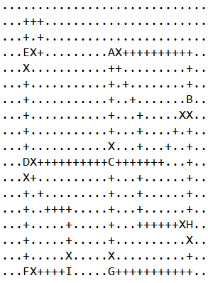

ALGORITHM AND SOLUTION STRATEGIES

Slide 14
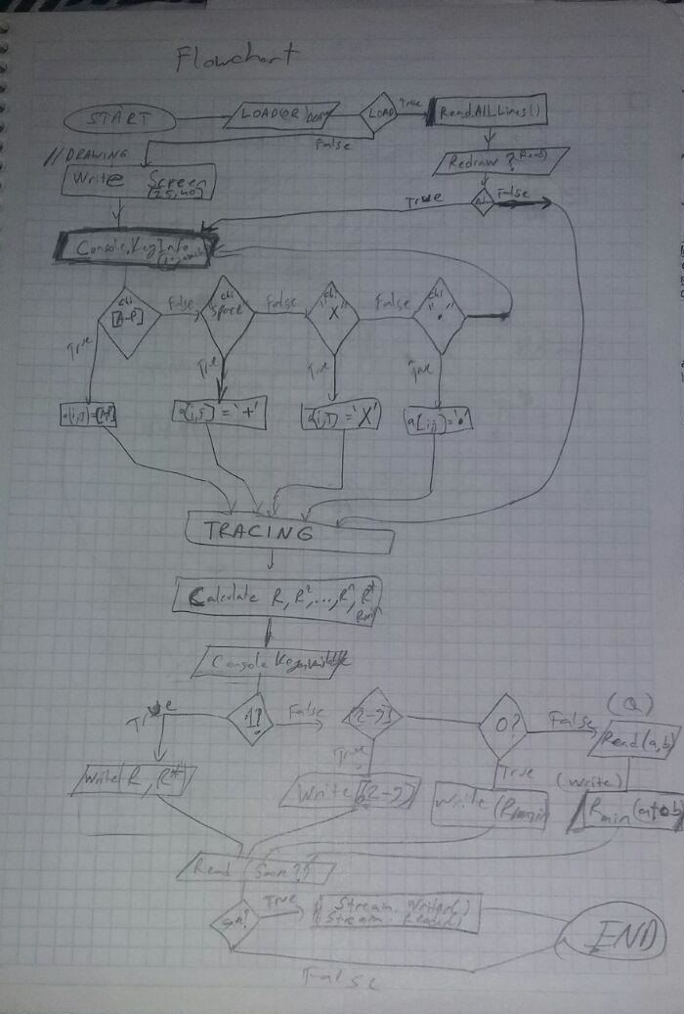
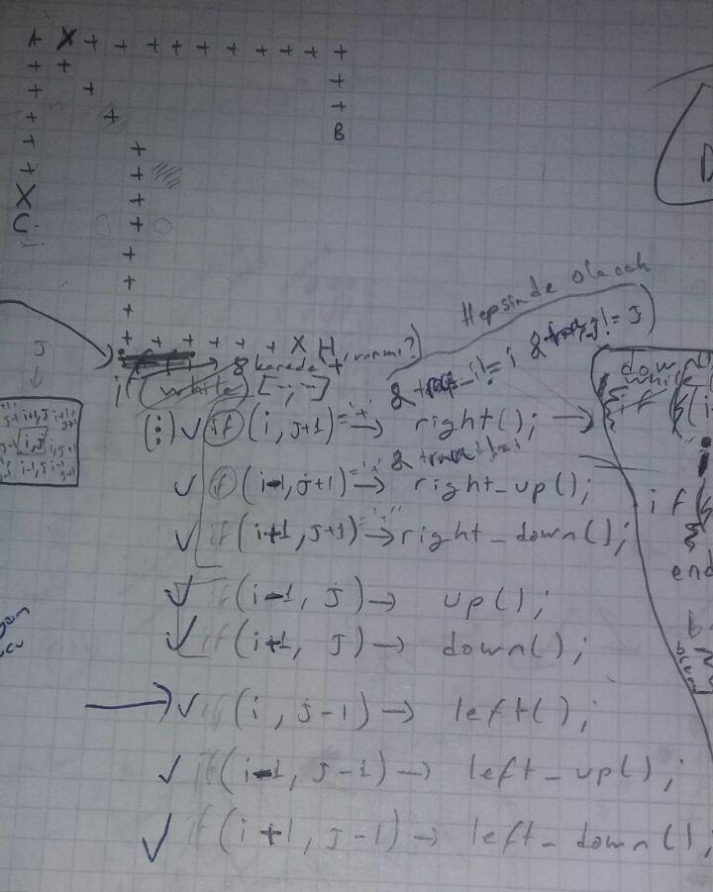
ALGORITHM AND SOLUTION STRATEGIES

Slide 15
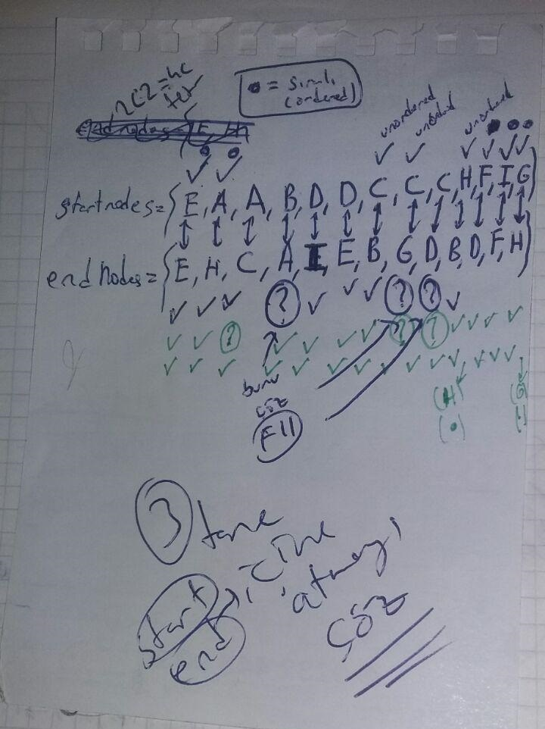
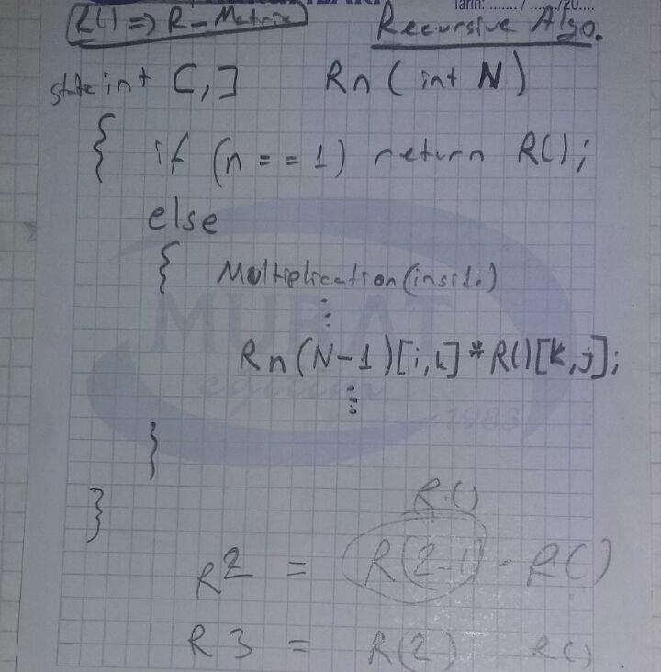

ALGORITHM AND SOLUTION STRATEGIES

Slide 16
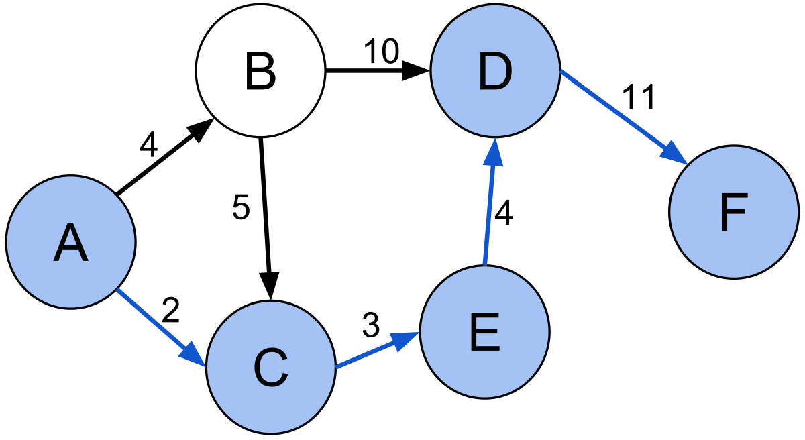
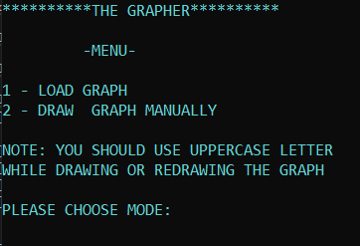
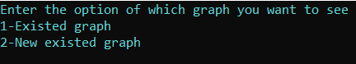
SCREENSHOTS
Main manu

Slide 17

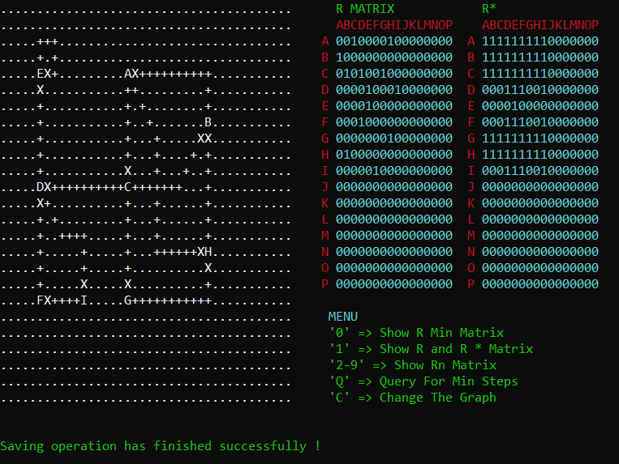
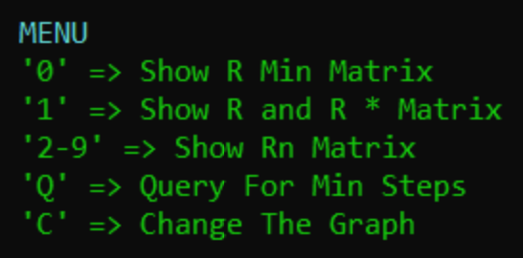
SCREENSHOTS
Inside menu

Slide 18
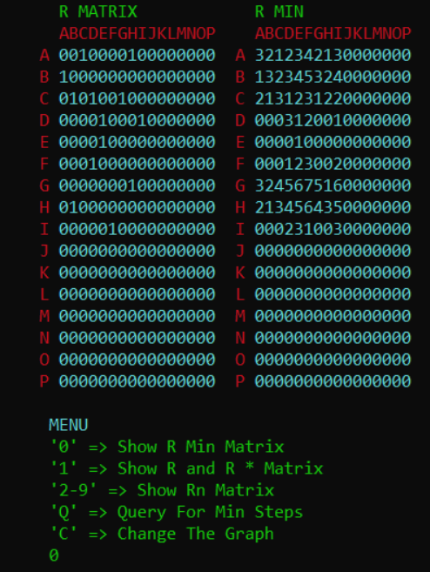
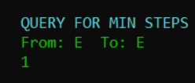

SCREENSHOTS
Query and Rmin

Slide 19
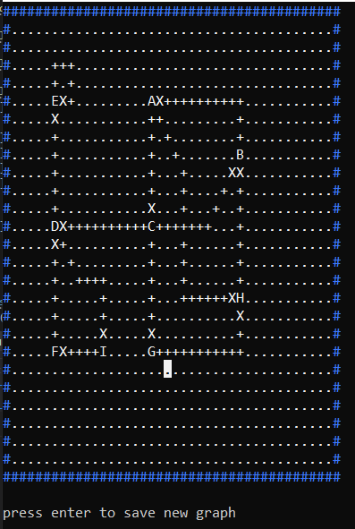
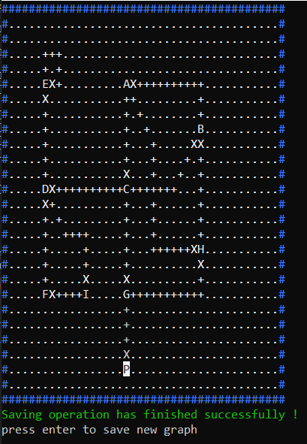
SCREENSHOTS
Saving

Slide 20


CONCLUSION
We have learned:
Usage of “Functions,Procedures,and Recursive”
Team work (Like IT Company)
New functions such as,
The project has been successfully finished on time exacly

Slide 21

REFERENCES
https://docs.microsoft.com/enus/dotnet/csharp/programming-guide/
https://www.canva.com
Lastly…

Slide 22

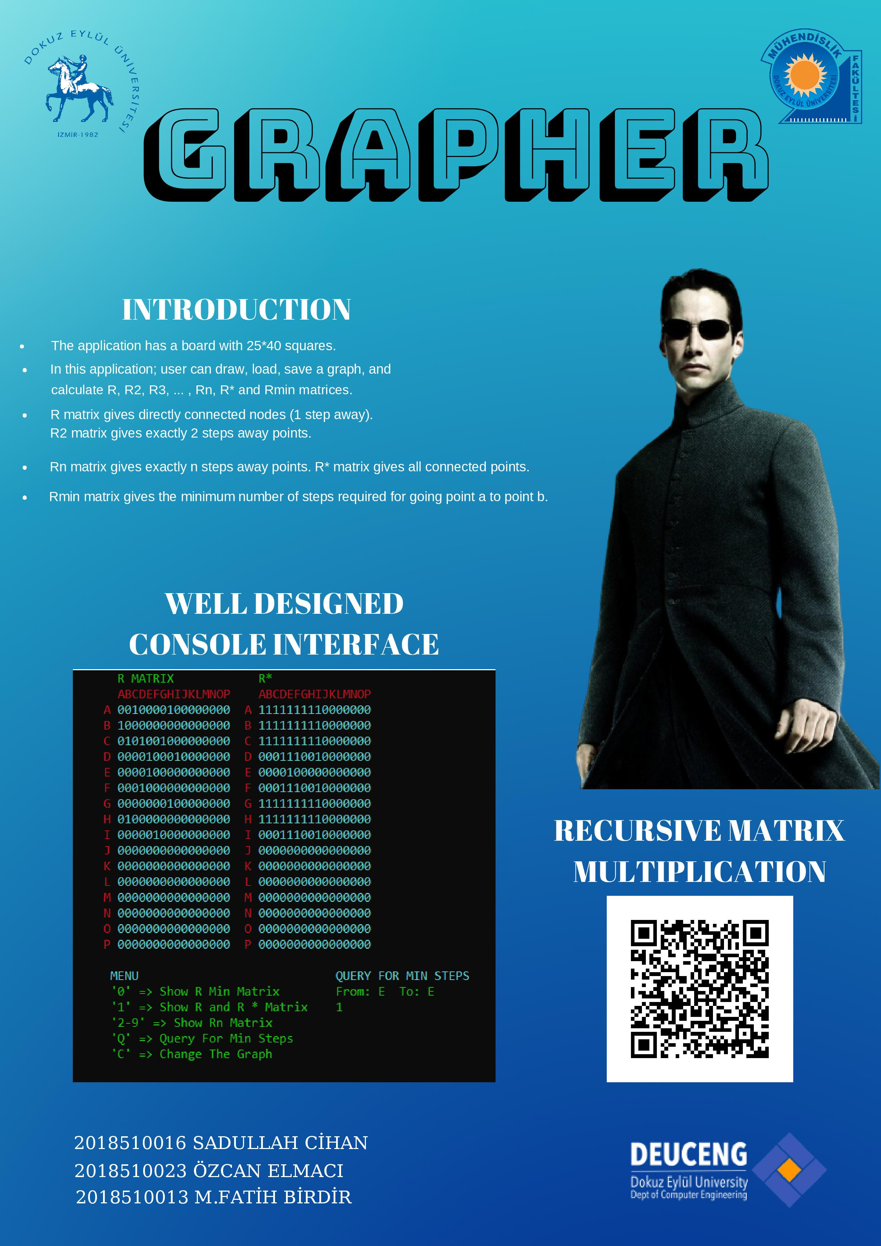
Recursıve algorıthm

Slide 23

THE END

